Slide 1
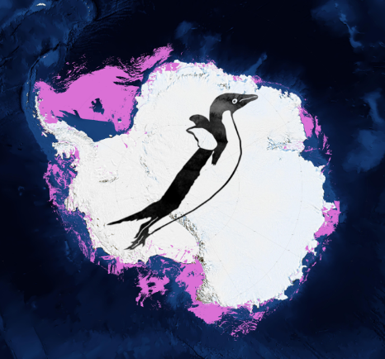
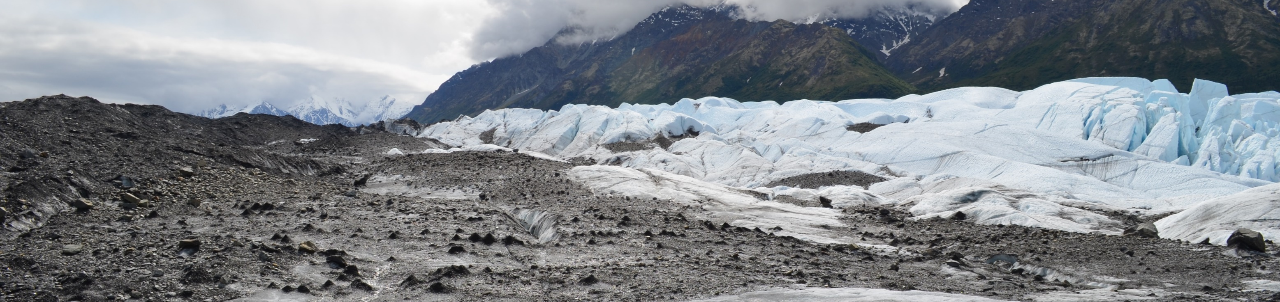
Team Aerosol Delta
Kimberly Casey, Karanjeet Singh, Nithin Krishna, Nick Thorne

Slide 2

Science Objective
To quantify anthropogenic and natural aerosols over Earth’s ice sheets and glaciers
To map patterns and changes from 2000 – present
To investigate land ice surface reflectance / albedo changes in relation to aerosol patterns.

Slide 3
Computational Challenge
Ingest multiple large Earth system data sets
Use high performance computing to efficiently reduce data sets,
perform computations on selected variables, output data
Visualize resulting data

Slide 4
What was achieved?
To quantify anthropogenic and natural aerosols over Earth’s ice sheets and glaciers
To map patterns and changes from 2000 – present
To investigate land ice surface reflectance / albedo changes in relation to aerosol patterns.

Slide 5
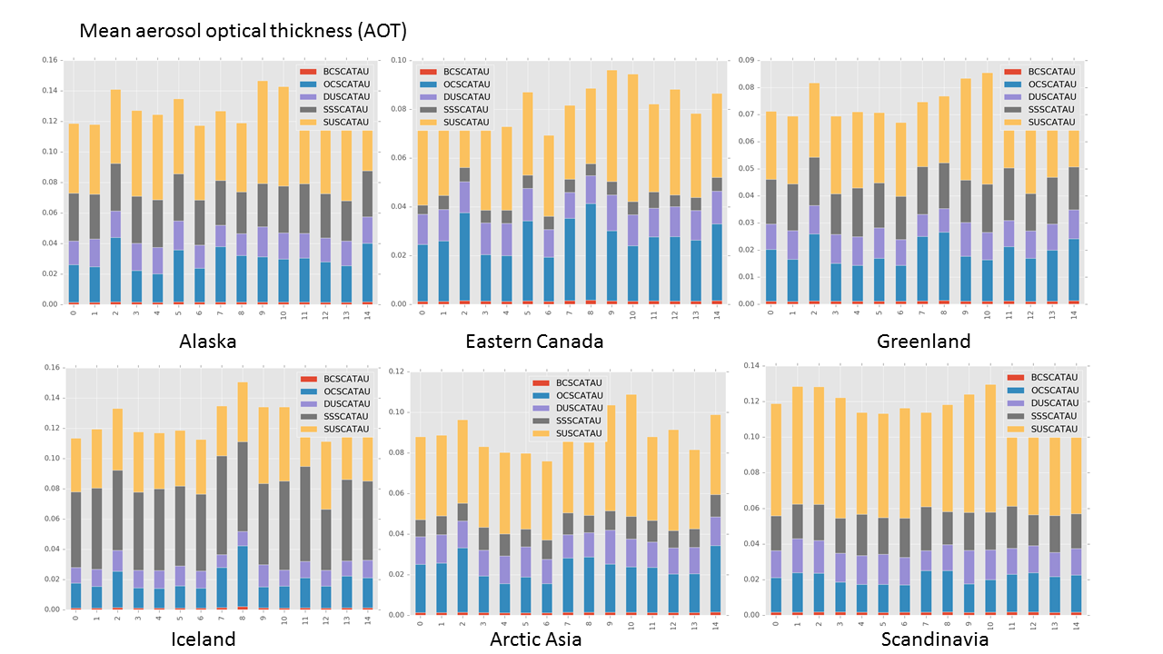
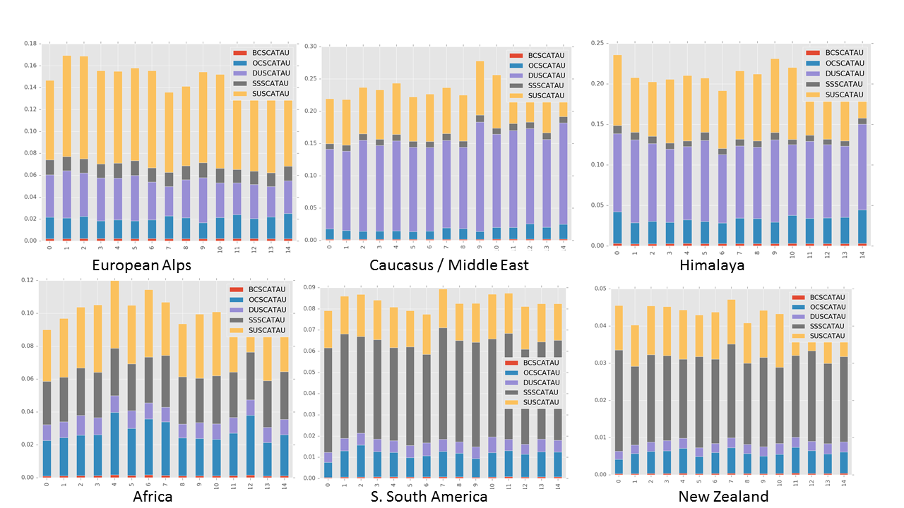
Highlights

Slide 6
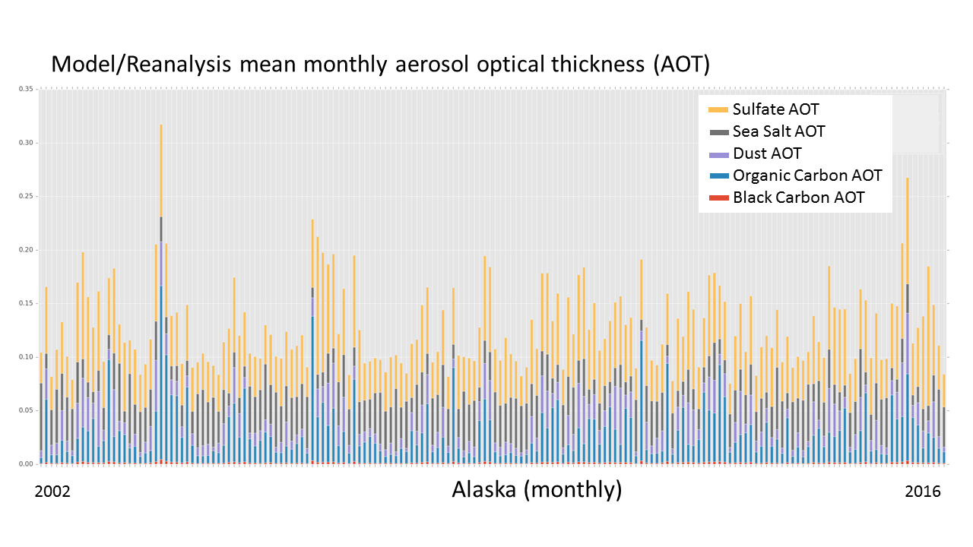
Highlights

Slide 7
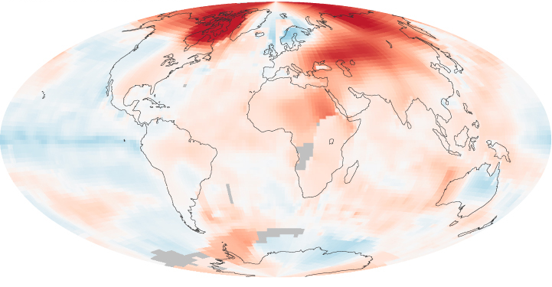
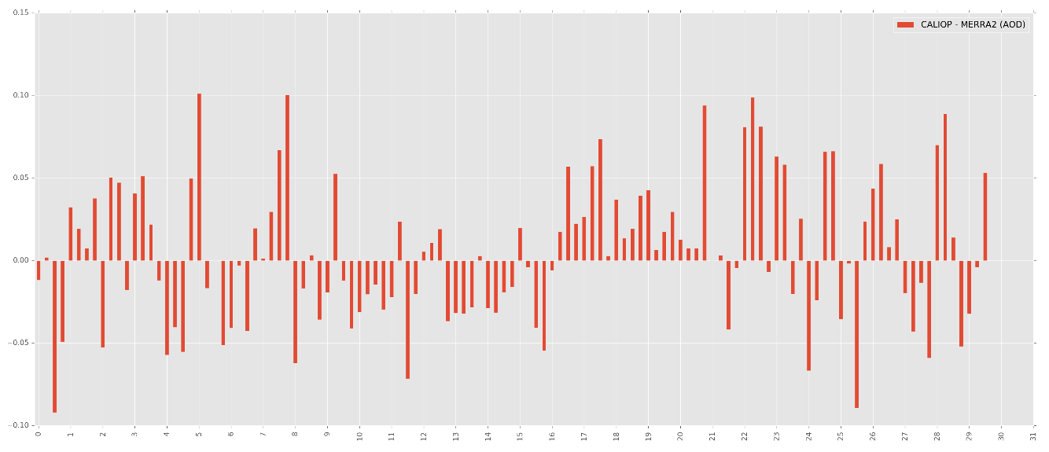
Highlights
Difference maps (observed - modeled)
Seasonal difference – Caucasus Mountains

Slide 8
Future goals:
Further explore first look at aerosol data (metadata filtering, regional biases)
Refine scripts – including native format output (netCDF, HDF) in addition to .csv output, for further analysis optimizing processing for XSEDE systems
Process surface reflectance / albedo data
Full aerosol, ice albedo data analysis
Potentially collaborate with other Hackathon project scientists

Slide 9
Comments to XSEDE
What is a typical job size from your project?
~175 processors, ½ wall clock time, with I/O per processor more realistic constraint than
memory.
What software was used to complete your task?
Software used included a combination of python, job launcher scripts, and supporting
libraries for HDF5, netCDF, and in future HDF(4).
What XSEDE digital services were used to support your research?
XSEDE digital services included, data transfers from Earth science data repository centers
to XSEDE systems, Globus Online, XSEDE Visualization systems (i.e. VisIT), XSEDE Data
Analytics systems (i.e. Wrangler for future use).
Has XSEDE documentation been helpful?
Yes, general XSEDE documentation, tutorials and TACC documentation were used.
Documentation and tutorials could be expanded.

Slide 11
Back up slides follow

Slide 12
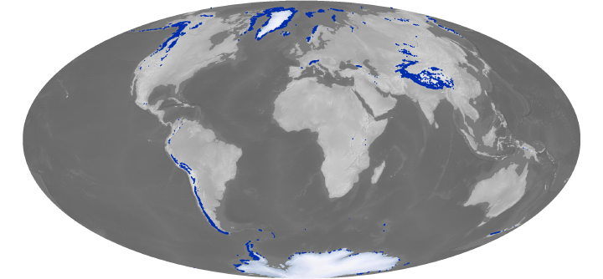
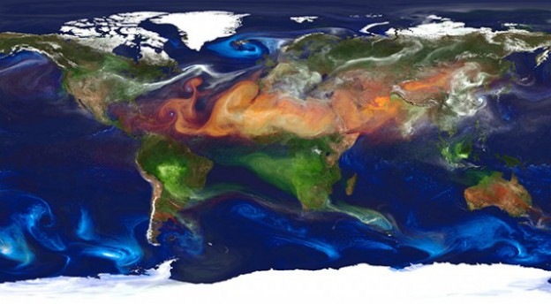
Data Sources:
Ice albedo
Land ice mask
Aerosols (model)
Aerosols (observation)

Slide 13
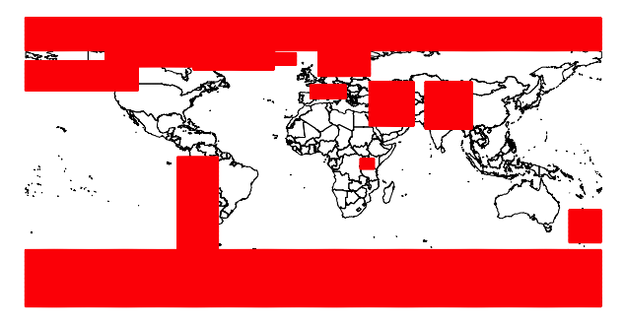
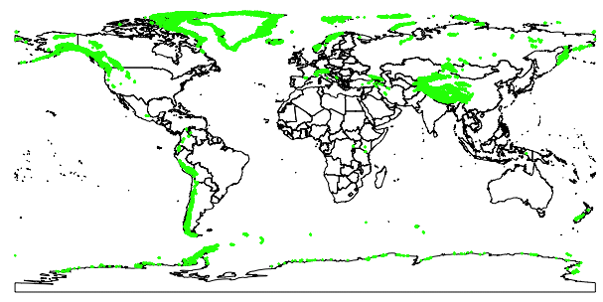
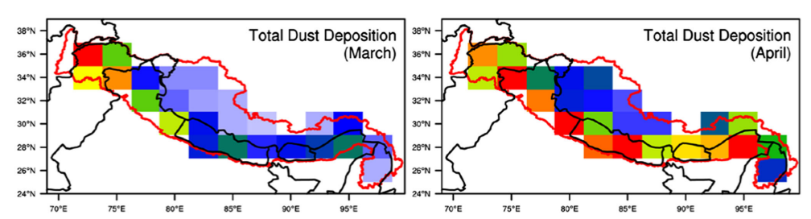
Data ingestion from a variety of formats
Land ice / Aerosol Regions of Interest and Strict Land Ice Mask
Black Carbon AOT
Dust AOT

Slide 14
Aerosol Process Flow:
Monthly data sets:
- observed AOT aerosols (dust, smoke, total)
- modeled AOT aerosols (dust, black carbon, organic carbon, sulfates, sea salt, total)
- Modeled surface mass concentration (dust, black carbon, organic carbon, sulfates, sea salt, (sum for total))
19 RGI regions
13 Land ice regions by (Buffer Zone, Strict Land Ice Mask Zone)
Alaska / Canadian Rockies
Arctic (Eastern) Canada
Greenland
Iceland
Arctic
Scandinavia
European Alps
Caucasus / Middle East
Himalaya
Africa
South America
New Zealand
Antarctica
Elastic search
By Buffer Zone
By Strict Land Ice Area
Temporal patterns:
- aerosols observed (by type)
- aerosols modeled (by type, mass)
Difference mapping:
Observations – Model/Reanalysis

Slide 15
Upcoming Goals:
Further explore first look at aerosol data (metadata filtering, regional biases)
Refine scripts – including native format output (netCDF, HDF) in addition to .csv output, for further analysis optimizing processing for XSEDE systems
Process surface reflectance / albedo data
Full aerosol, ice albedo data analysis

